Slide 1
Courant Math 2799.001
Modeling & Risk Mgt of Bonds & Securitized Products
Lecture 5: S-Curve Monte Carlo OAS model, CRT, CMBS
April 22, 2024
Prof: Rodney Sunada-Wong rsw8@nyu.edu
TA: Edison Lee el2700@nyu.edu

Slide 2
Topics
Previous Homework
A more complex Toy Monte Carlo OAS model
Hedging
Model Durations vs Empirical Durations
A Review of Securitization Concepts
Credit Enhancement
CRT’s
RMBS (Non-Agency MBS)
CMBS, CMBX
Homework

Slide 3
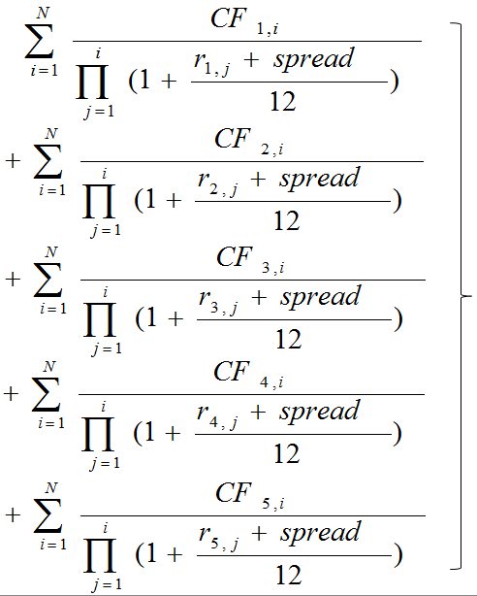

Homework from Previous Lecture - Build a Toy OAS Model
1) Given: a Pass-Through
2) Given: N interest rate paths through time
3) Given: prepayments along each path
4) Generate cash flows assuming curtailments
5) Discount the cash flows using a spread over LIBOR rates (L-OAS) such that the average of the PV across all the interest rate paths equals the Market Price observable for the MBS
This step requires solving for the OAS
Your Passthrough Model

Slide 4
Homework from previous lecture (cont’d)
Build a toy OAS model based on
Pass Through
Five paths of 1mth LIBOR forwards (-40bps, -20, 0, +20, +40)
Five paths of CPRs
Calculate the WAL each month through time for each path
Solve for the OAS
Assuming CPRs do not change when rates are shocked, calculate
PV01 (change in PV for +1bp shock to interest rates)
PV-100 (change in PV after shocking forwards down 100bps)
PV+100 (change in PV after shocking forwards down 100bps)
Calculate the credit spread sensitivities
CS PV01 (change in PV for +1bp shock to OAS)
CS PV-100
CS PV+100
Key observations?

Slide 5
Homework from previous lecture (cont’d)
4. Hold OAS constant and calculate chg in PV if rates drop 100bps, rise 100bps given:
Shocked 1mth LIBOR forwards
For -100, use: -60, -80, -100, -120, -140
For +100, use: +60, +80, +100, +120, +140
Paths of CPRs corresponding to the forwards
Key observations?
Plot in one graph #2, #4
X-axis: shock to forwards
Y-axis: chg in Price
Explain why PV changes at -100, +100 are different for #2 vs #4
Describe the relationship of PV changes for #3 to #2 and #4
Readings
Salomon Smith Barney Guide to MBS and ABS
Chapters 1, 4, 5

Slide 6
A More Complex Toy OAS Model
New for this week:
1) Given: a Pass-Through
2) Given: 500 (and up to tens of thousands of) interest rate paths (LIBOR forwards) through time
2a) Calculate “at market” Swap Rates at each point in time in the future
2b) Calculate current mortgage rates at each point in time assuming they are Xbps (e.g. 175bps) higher than Swap Rates*
3) Given a PSA curve: calculate prepayments along each path
4) Generate cash flows
5) Discount the cash flows using a spread over LIBOR rates (L-OAS) such that the average of the PV across all the interest rate paths equals the Market Price observable for the MBS
This step requires solving for the OAS
* This assumes there is a relationship (e.g. a spread) between Swap Rates and Mortgage Rates

Slide 7
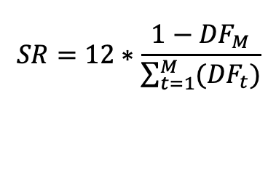
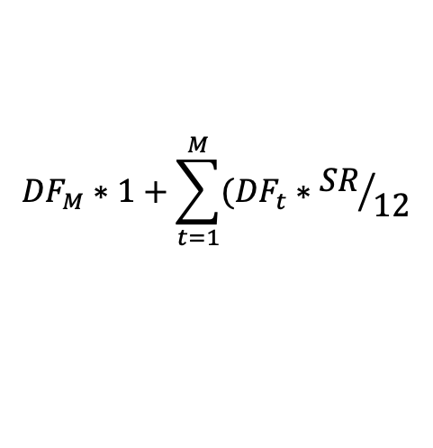
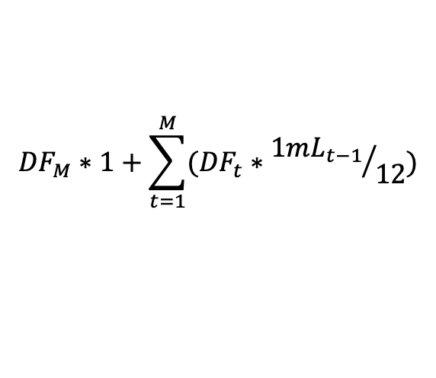
How to calculate “At-Market” Swap Rate from Forwards
A swap exchanges cash flows between two parties
periodic fixed rate coupons plus principal at maturity vs
periodic floating rate coupons plus principal at maturity
An At-market swap rate: the rate on the fixed rate leg of a swap such that the market value of the fixed leg equals the market value of the floating leg
Market Value of the Floating Leg:
(assuming Notional = 1)
Market Value of the Fixed Leg:
So, we just need to solve for the Swap Rate (“SR”) where the Market Value is 1 (assuming notional = 1)
We can simplify SR to equal:
$${DF}_{M}∗1+\sum_{t=1}^{M}{{(DF}_{t}}∗{{1mL}_{t−1}}/{12})$$
Note that the PV of the floating rate cash flows is Par on reset date*
Why?
$${DF}_{M}∗1+\sum_{t=1}^{M}{{(DF}_{t}}∗{SR}/{12}$$
$$SR=12∗\frac{1−{DF}_{M}}{\sum_{t=1}^{M}{{(DF}_{t})}}$$
* The day each month when the floating interest rate (LIBOR) is determined

Slide 8
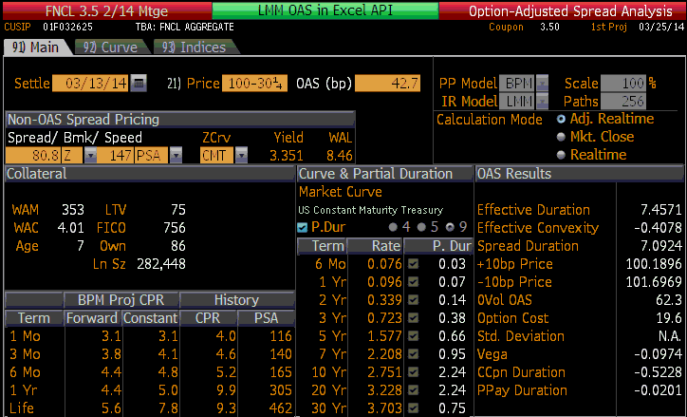
Hedging
The investor in a mortgage or a pass through is short the prepayment option
Recall: The difference between the 0-volatility spread and the OAS is an indication of the cost of the option provided to the mortgagors (the people who borrowed the money)

Slide 9
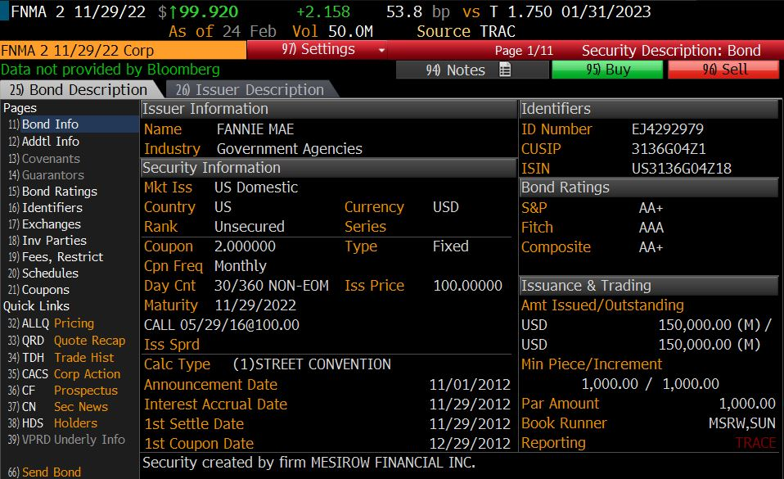
Hedging by issuing debt
FNMA, FHLMC fund their “retained” portfolios by issuing debt.
They can try to customize their Liabilities to try to hedge the prepayment risk they have
A large proportion of Agency Debentures are “callable”!
By issuing callable debt, the GSE is long a bermudan call
=> helps hedge the short prepayment option

Slide 10
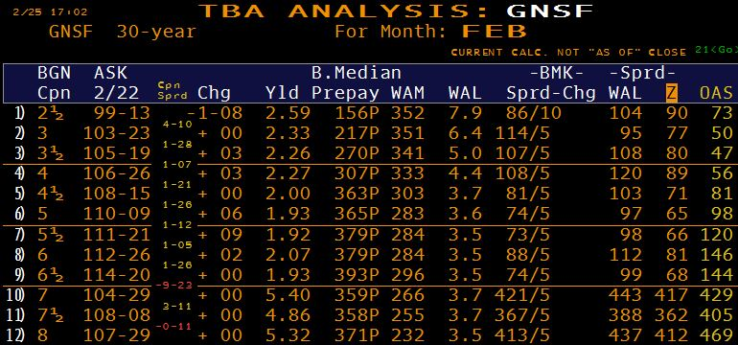
Hedging with TBAs
As discussed, a bank that issues mortgages (to borrowers) can hedge interest rate risk from the time it locks the loan to the time the loan funds and the bank sells the mortgage (into a pool to be securitized) by selling a TBA (as discussed in an earlier lecture)
A GSE or an investor who buys a passthrough also might hedge with TBAs
Remember:
just five parameters define a TBA
As Cpn increases, how do:
ASK prices change? increase
PSA speeds chg? increase
WALs change? decrease

Slide 11
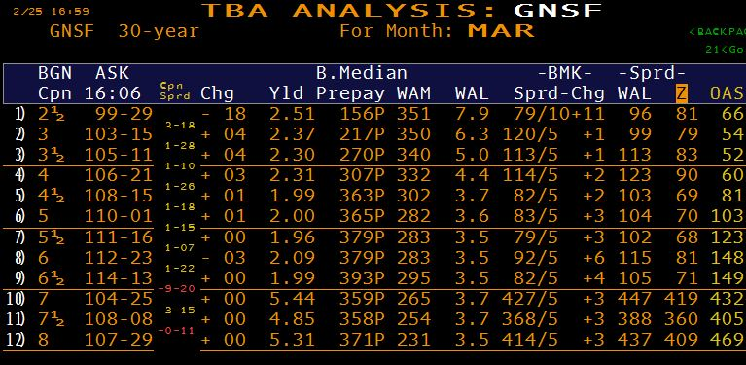
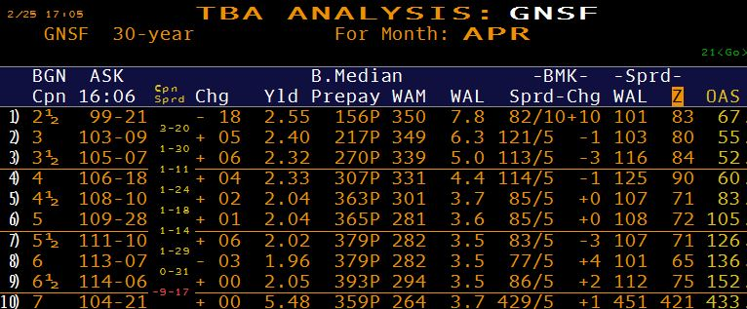
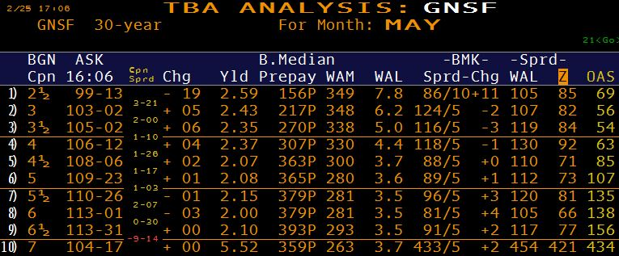
Hedging with TBAs (cont’d)
Settlements in other months

Slide 12
Model Durations vs. Empirical Durations
So far, we’ve discussed model-driven sensitivities
As noted, these models estimate behavior
=> The models’ sensitivities are estimates and are subject to error!
Empirical duration calculation
Regress market prices of MBS against a particular factor (or factors) e.g.
10yr Treasury yield
10yr Swap rate
etc.
Model | Empirical
Forward-looking | Backward-looking
Have the ability to change one factor at a time or change more than one factor | Everything is moving at the same time => challenging to isolate the impact of solely one input changing
Theoretical (will likely be wrong in some way) | Empirical (so accurate, but the markets are affected by sentiment, expectations, supply/demand factors, AND the past may not necessarily predict the future)

Slide 13
Model vs Empirical Durations
Since conditions change, be wary of using empirical durations for hedging over longer periods of time
Notice how empirical hedge ratios kept increasing, while modeled ratios were decreasing.
Later, empirical ratios dropped very quickly, in a sense, “catching up” with hedge-ratios predicted by models

Slide 14
Impact of changing prepayment speeds
Holding interest rates and volatility constant, how would MBS prices be impacted
If the Market Value of a Passthrough was par (price = 100%) and then prepayment speeds increase and the yield curve is
1) flat
2) upward sloping
If the Passthrough is a “premium bond” (price > par), and then prepayment speeds increase and the yield curve is
1) flat or
2) upward sloping
If the Passthrough is a “discount bond” (price < par), and then prepayment speeds increase and the yield curve is
1) flat or
2) upward sloping
Breakout Rooms

Slide 15
A Review of Securitization Concepts
What is Securitization?
A financing tool
Securities are backed by specific assets
Cash flow from collateral (assets) pays back securities
Upfront Cash
"Issuer"
(Sponsor)
Obligors
Credit Cards
Auto Loans
Dealer Floor Plans
MarketPlace Lending
Cellphone Receivables
Subprime (Home Eqty)
Student Loans
Payments over time
Sale or pledge of assets
(“True Sale”)
Proceeds from sale of securities
SPV
(Issuer)
Proceeds from sale of securities
Issues securities
Investors
Source: M. Adelson, adapted from
SEC Staff Report, May 1992

Slide 16
The Role of the Trustee
To protect investors: A Trustee* is a neutral third party who administers the duties of the SPV (e.g. ensures payments and distribution of assets are executed properly)
Upfront Cash
"Issuer"
(Sponsor)
Obligors
Payments
Transfers payments minus fees
Credit Cards
Auto Loans
Dealer Floor Plans
MarketPlace Lending
Cellphone Receivables
Home Equity
Student Loans
Sale or pledge of assets
Proceeds from sale
SPV
(Issuer)
Trustee
Transfer of assets
Issues securities
Proceeds from sale
Transfers net payments
Investors
Source: M. Adelson, adapted from
SEC Staff Report, May 1992
* e.g. Bank of NY Mellon

Slide 17
Securitization
Why would Issuer securitize?
Funding
Diversifies funding sources
Increases liquidity
Lowers the cost of funds
Increases the “velocity” of the balance sheet
Increases Investor Base
Arbitrage
Selling assets into SPV
Risk Transfer - separates credit of assets from Issuer’s credit
Results in Capital Relief for Banks
”Bankruptcy remote” (something an investor would care about)
ALM - Matches Assets of SPV with Liabilities issued by SPV

Slide 18
Securitization
Benefits
Lower borrowing (mortgage) rates
Wider availability of credit (mortgages) to borrowers
Equalization of rates nationwide
Standardization of the application process / faster decisions
Higher rate of home ownership
Improper Uses of Securitization
Transaction lacks economic substance / company retains risks and benefits of ownership
But achieves
Accounting results (Company “sells” assets / shrinks balance sheet )
Frees up Capital
Gain-on-sale accounting: Book inflated earnings based on flawed projections

Slide 19
Credit Enhancement
If no GSE guarantee (i.e. a Non-Agency securitization), then structures require credit enhancement
Senior-Subordinate
Overcollateralization
Reserve Account / “Excess Spread”
“Wrap”: A financial guarantee provided by highly-rated Insurer
A surety bond issued by monoline insurance company which guaranteed timely payment of interest and ultimate repayment of principal
Borrower pays for mortgage insurance to cover losses up to a specified LTV
Very common before the Financial Crisis. Very rarely used now.
Why?
Source: C. Mohebbi
Notes:
Whole loan – dollar of loss impacts investor dollar for dollar
Subordination –
under default, losses first hit subordination
no default, principal CF pro-rata or sequentially (senior-sub)
which will rating agencies require greater subordination –
Q to ask: if 90/10 and another 93/7, then which one pro-rata, which one sequential
if sequential, then subordination increases
if time sequential, then earlier tranches are higher quality
if subordinates eaten through, then time sequentials will be collapsed and become pro-rata
OC – as time goes by OC increases; excess interest is used to pay down senior bonds; OC increases until reaching a certain level
WRAP – does not wrap the whole deal e.g. only above a certain rating e.g. A.
MBIA wraps it and is downgraded, but collateral is performing well
what happens to rating of bond – downgraded
Some investors won’t buy if they have too much exposure to an insurer
Reserve – initial amount builds up to a certain level; above that then pays equity
size is a function of rating agency requirements
How do we choose which one to issue? Whichever gives maximum proceeds

Slide 20
Credit Enhancement
Typical Credit Enhancement Structure RMBS
Subordination: Interest and principal that would have been distributed to subordinate classes is re-directed to more senior classes
Overcollateralization: More assets (loans) than liabilities (securities issued)
Reserve Account / Excess spread
Excess funds from the interest paid on the home equity loans after expenses are kept in a Reserve Account
Excess spread accelerates principal payments to bondholders
Class A
Class M-1
Class M-2
Class B
Overcollat
Excess
Source: C. Mohebbi

Slide 21
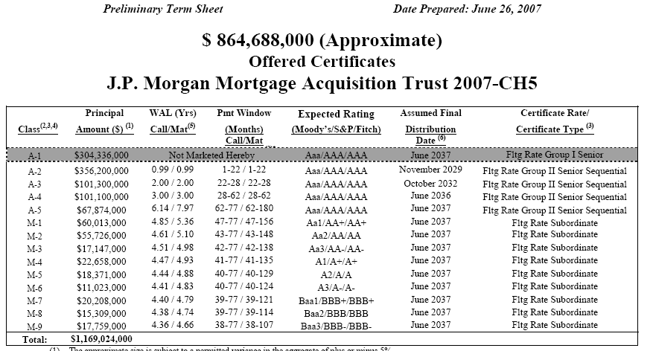
Credit Enhancement
Credit-Tranching and Time-Tranching for RMBS (in 2007)
Source: C. Mohebbi

Slide 22
RMBS / Non-Agency MBS (Sub-prime)
Collateralized by
Alt-A -- prime credit characteristics
Limited income documentation (“Stated Income”)
Limited asset documentation (“Stated Assets”)
Non-owner occupied property
High LTV
In years preceding the crisis, the definition was stretched
Subprime – weak credit (low FICOs)
Backed by 2/28, 3/27
Option ARMs
In years preceding crisis, quality of underwriting was very inconsistent
Currently
No origination of these kinds of loans
There is origination of loans for weaker credits, but
Full documentation
Traditional amortizing

Slide 23
Non-Agency MBS (Jumbo)
Collateral
Loan size exceeds GSE maximum
Credit quality is usually very strong
Fixed-rate or floating rate collateral
Amortizing or non-amortizing
Non-amortizing means interest-only “IO” until maturity, when principal is paid
not to be confused with “an IO”, which is just interest and no principal
A variety of structures found in agency CMOs were usually found in non-agency deals for jumbo collateral
Currently
There is plenty of origination
Securitization market is dormant
These loans are mostly “retained” instead of sold into securitizations

Slide 24
Credit Risk Transfer Securities (CRT)
During the financial crisis, the government had to “bail out” FNMA (“Fannie Mae”) and FHLMC (“Freddie Mac”).
To reduce taxpayer’s risk, the GSE’s now transfer a portion of the credit risk of certain pools by issuing “CRTs”
Unsecured debt obligations of GSEs structured as credit-linked notes. Performance is linked to a reference pool of loans that have been sold into MBS guaranteed by the GSEs.
If there are credit losses, the GSE is not obligated to repay that portion of principal to investors.
Freddie:
“Structured Agency Credit Risk” (STACR),
“Agency Credit Insurance Structure” (ACIS) bonds
From 2013 to mid-2022, $99Bn of CRT bonds issued linked to $3 Trillion of mortgages*
Fannie :
“Connecticut Avenue Securities” (CAS) bonds
“Credit Insurance Risk Transfer” (CIRT) bonds
From 2013 to late 2022, $91Bn of CRT bonds issued linked to $3Tn of mortgages**
https://freddiemac.gcs-web.com/news-releases/news-release-details/freddie-mac-credit-risk-transfer-delivers-record-first-half
https://capitalmarkets.fanniemae.com/media/22751/display

Slide 25
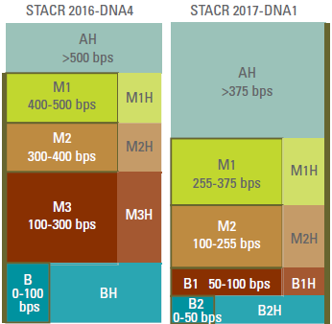



CRT details
Sequential structure
Principal and interest payments are paid top-down
Pays LIBOR + spread (uncapped floater).
Lower Mezz and subordinates do not receive principal until senior tranches paid off
Credit Losses allocated from the bottom-up
Currently only M1, M2 and B1 tranches are offered
The GSE’s retain at least 5% of each offered tranche
Source: Wells Fargo Securities

Slide 26
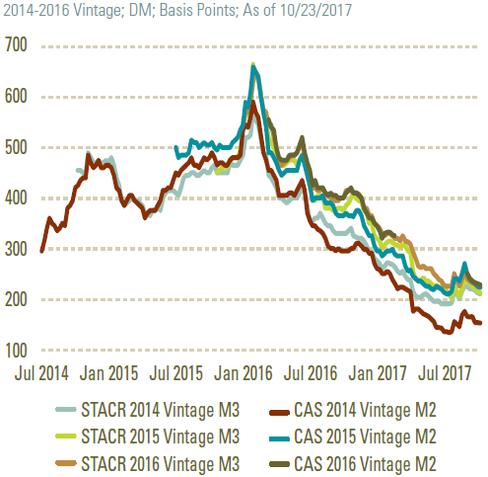
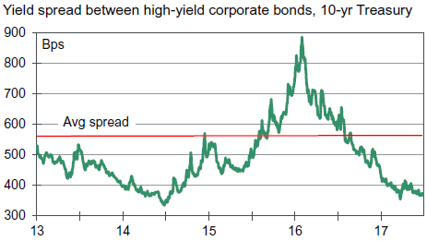
CRT Ratings and Credit Spreads
Ratings
M1, M2 are investment grade (“IG”)
M3s: Some are IG, some NIG
Credit Spreads
Behaves similar to corporate bond spreads
Source: Wells Fargo Securities
Source: Moody’s

Slide 27
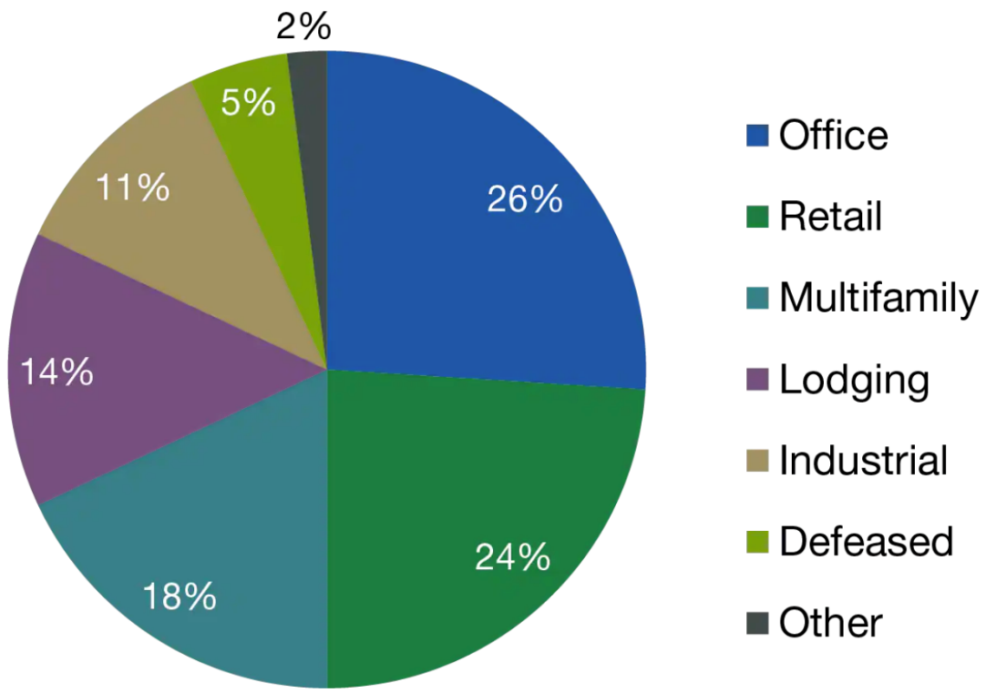
CMBS
Property Type Breakdown of
U.S. CMBS Market (12/31/22)
Security backed by loans on:
Office, Retail, Multi-family, Hotels
Asset Types:
Conduit deal: multiple borrowers (e.g. many dozen), or
Single-Borrower with portfolio of properties (real estate developer, e.g. GGP)
Single-Asset (Time Warner building on 59th & Central Park West)
Fusion Deal: a combination of multiple borrowers and a single asset
Issuer Types:
GSE-backed (multi-family housing, healthcare)
Private-Label
Source: Morningstar. https://www.lordabbett.com/en-ie/financial-intermediaries/insights/investment-objectives/investment-brief--commercial-mortgage-backed-securities--cmbs-.html
“Defeased” bonds where the issuers posted cash or treasuries to meet liability obligations

Slide 28
CMBS
Characteristics:
“Non-Recourse”:
Residential mortgages: payments are from borrower’s income, assets
Commercial loans: only from income produced by the properties
Loans typically balloon, not fully amortizing (e.g. 10yr with 30yr amort)
Typically have prepayment protection or yield maintenance/defeased
Like Resi MBS, CMBS loans are cross-collateralized (properties pooled/bundled)
Structures
Senior-subordinated structures
Credit enhancement (OC, excess interest)
Sequentials, PACs, floaters, IOs
Servicing
If conduit deal, Master Servicer (data-oriented)
If default or trigger, Special-Servicer (expertise)

Slide 29
CMBS
Key Metrics for evaluating credit risk:
Debt Service Coverage Ratio (DSCR)
(Rental Income – operating expenses)/ Interest Payments
Previously >=1.25 DSCR; now 1.5-ish DSCR
Loan-to-Value ratio,
Present value of expected cash flows + reversion value, or Appraised value
Previously 80% LTV; now 55-75% LTV

Slide 30
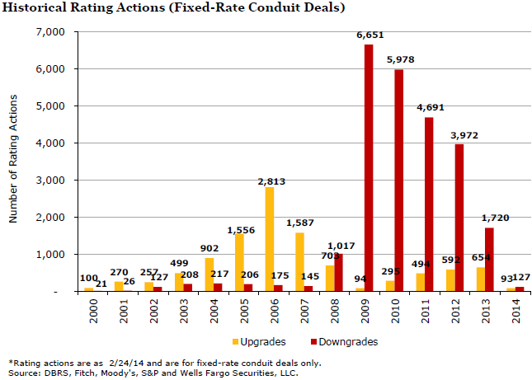
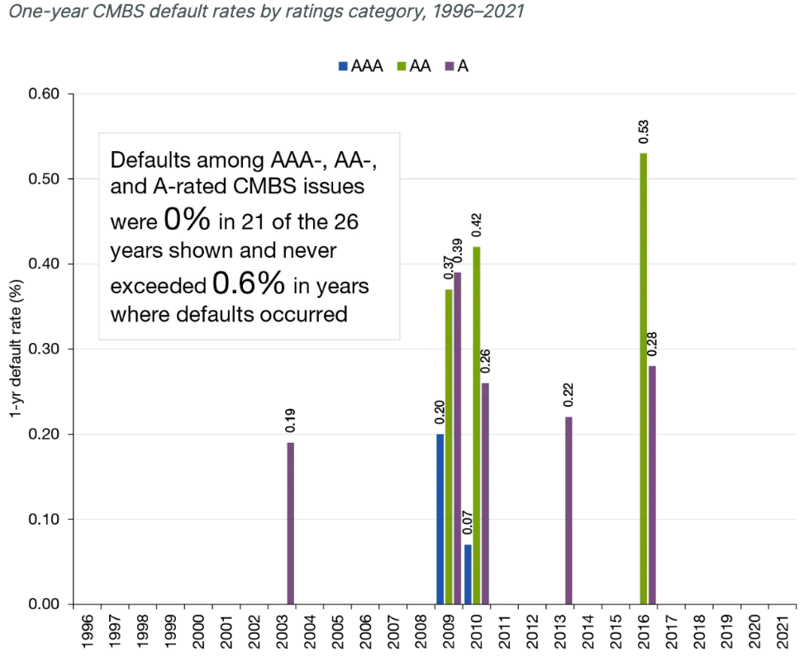
CMBS Upgrades vs Downgrades pre- and post-Financial Crisis
Many downgrades post-Financial Crisis, but many fewer in the years since.Expect many more downgrades in 2020 and beyond
Default rates historically very low for CMBS
Source: Wells Fargo Securities, LLC
Source: S&P Global Ratings Research. Data as of 12/31/21 (latest available, derived from a yearly report).

Slide 31
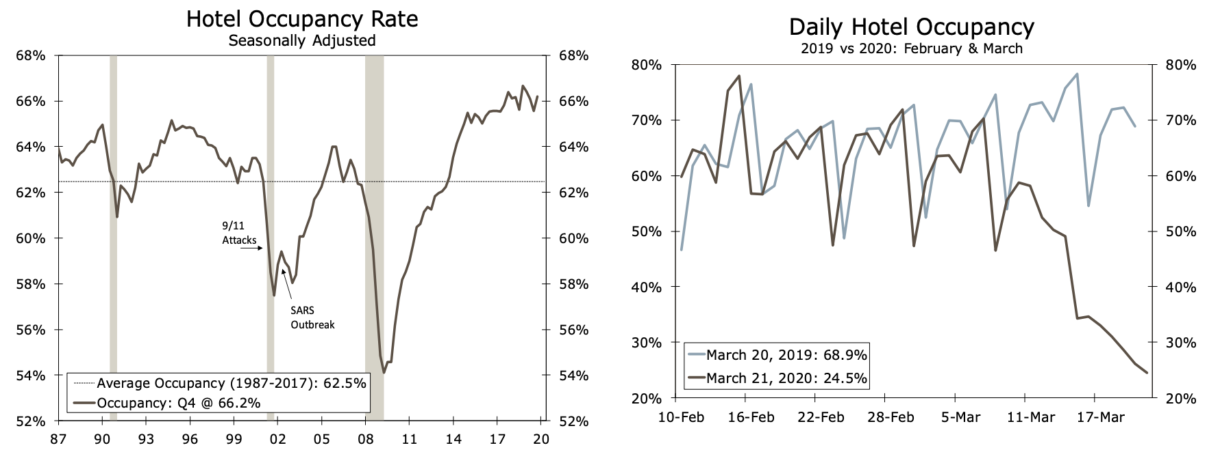
CMBS: Coronavirus impact on different sectors
Office – not as great initially, but long-term implications are highly questionable. Will people WFH???
Retail – Retail had already been impacted by online shopping. COVID: harsh impact initially
Multi-family – Expect greater delinquencies for apartments with lower rents (vs higher rents)
Hotels – Hotels already impacted by AirBnB, etc. COVID: Harsh Impact, but now people are traveling
Occupancy Levels have plummeted below Financial Crisis occupancy levels
Source: https://www08.wellsfargomedia.com/assets/pdf/commercial/insights/economics/real-estate-and-housing/cre-chartbook-2019Q4.pdf

Slide 32
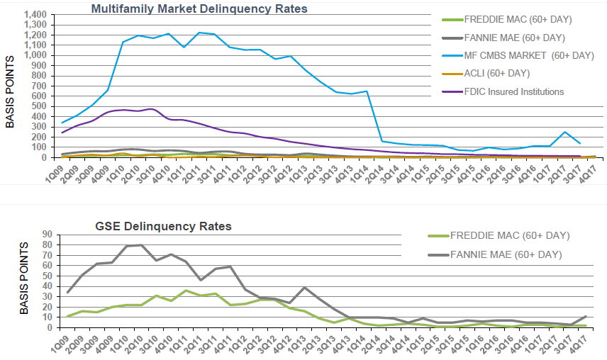
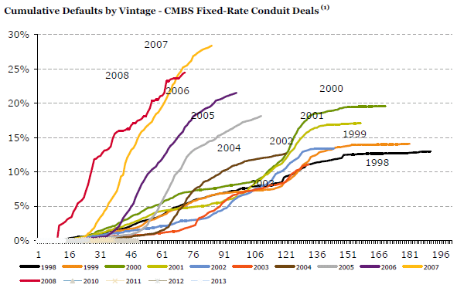
CMBS Delinquency, Defaults pre- and post-Financial Crisis
Underwriting standards weakened in the years leading up to the Financial Crisis
Agency Multi-Family delinquencies also rose, but not nearly as high as Private Label
2007 and 2008 vintages performed poorly from the outset. Older vintages’ collateral had years of appreciation before the Financial Crisis
Source: Freddie
Source: Wells Fargo Securities, LLC

Slide 33
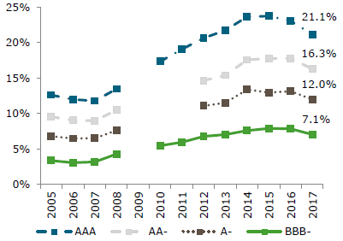
CMBS enhancement levels pre- and post- Financial Crisis
Post-crisis: CMBS 3.0
Enhancement levels increased, and leveled off / decreased. Subordination levels are similar now
Source: Wells Fargo Securities, LLC

Slide 34

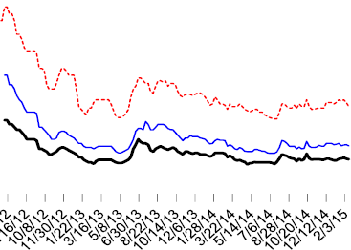
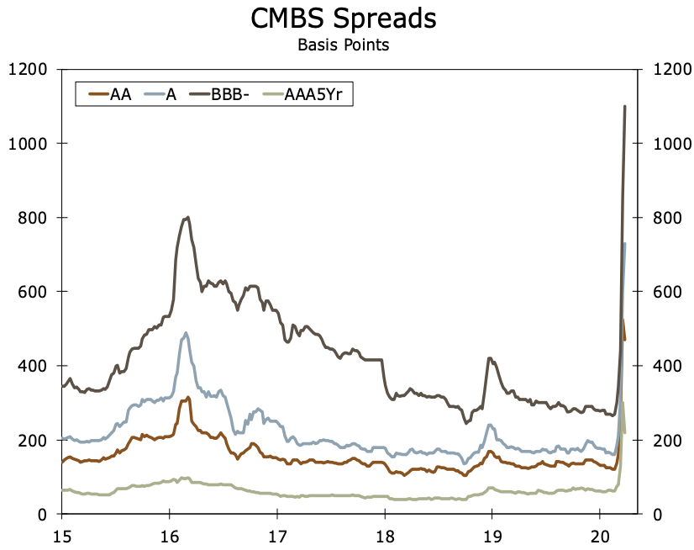

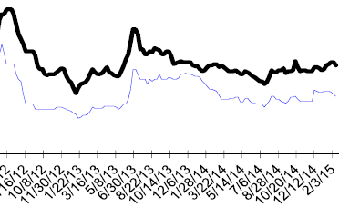
CMBS Spreads post Financial Crisis and in 2020
2020:
Spreads blew out and tightened after FRB action.
However, the story is not over
Source: Wells Fargo Securities, LLC

Slide 35
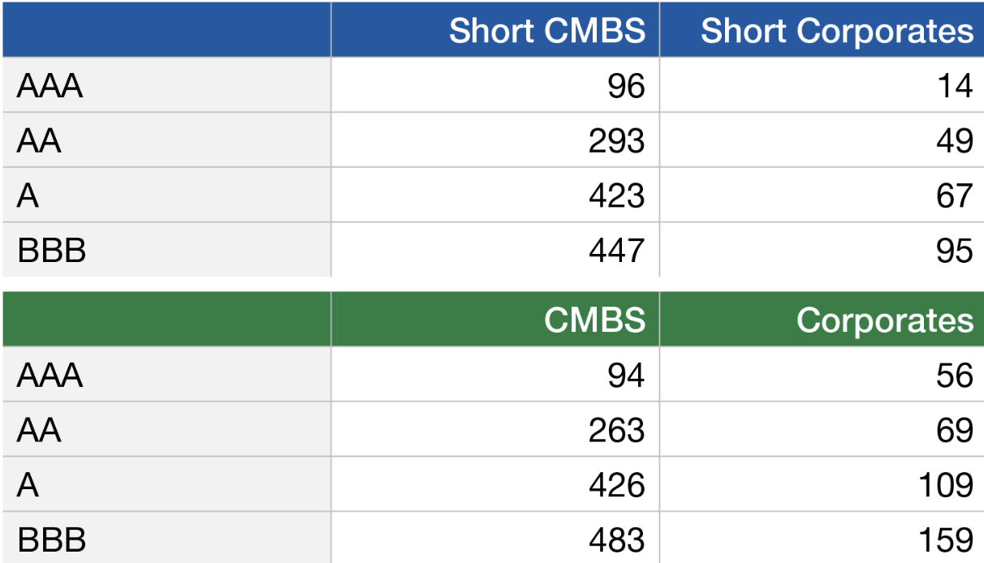
Spreads in 2022: CMBS vs Corporates
In the past, CMBS spreads were similar to Corporate Bond spreads
But because of competition from online shopping and WFH, spreads are significantly wider than Corporate Bond spreads
Source: Short-term CMBS: Bloomberg U.S. CMBS 1-3.5 Year Index. Short-term corporate: Bbg U.S. Corporate 1-3 Year Total Return Index. CMBS: Bbg U.S. CMBS Investment Grade Index. Corporate bonds: Bbg U.S. Corporate Total Return Index.
https://www.lordabbett.com/en-ie/financial-intermediaries/insights/investment-objectives/investment-brief--commercial-mortgage-backed-securities--cmbs-.html

Slide 36
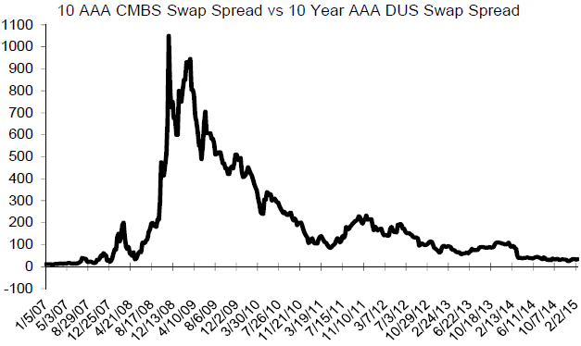
CMBS Private Label Spreads vs DUS pre- and post-Financial Crisis
Private label CMBS spreads are much more volatile than
Agency-wrapped CMBS spreads (FNMA’s Delegated Servicing and Underwriting CMBS, or “DUS”)
Source: Wells Fargo Securities, LLC

Slide 37
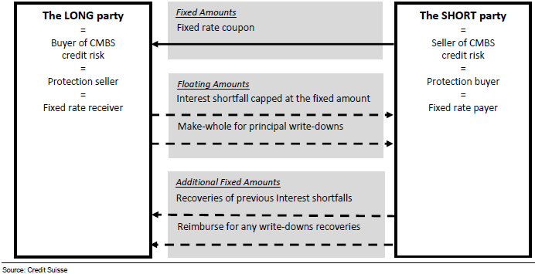
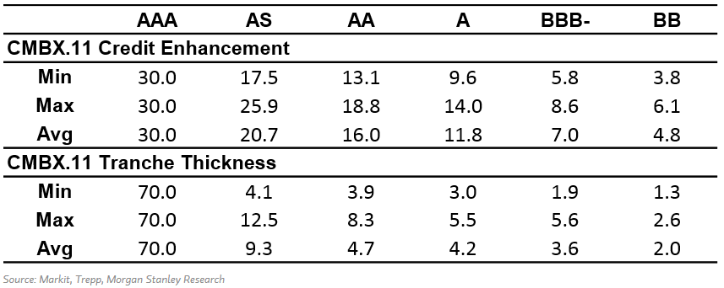
CMBX
Standardized indices
constructed by MarkIt
https://www.markit.com/en/products/data/indices/structured-finance-indices/cmbx/cmbx-prices.page#
Basket
25 single-name CDS equal-weighted
By vintage and by rating
Cash settled
Pay-as-you-go
not terminated at first default
Each component remains outstanding until reference obligation paid down or fully written down

Slide 38
Homework Part I
Build a toy OAS model based on
Pass Through, described on a subsequent slide, and the 500 LIBOR paths and S-Curve for which a link is provided in Contents
Use at least 20 paths of 1mth LIBOR forwards (will provide 500 paths)
Calculate the 10yr par swap rate at each month in the future
At month 240 onwards, just use the par swap rate you calculate for month 240
Assume mortgage rates are the 10yr par swap rate +175bps (a simplistic assumption)
Calculate the refi-incentive and lookup the PSA (interpolate*)
Generate cash flows
Solve for the OAS
Assuming CPRs do not change when rates are shocked, calculate
PV01 (change in PV for +1bp shock to interest rates)
PV+50 (change in PV after shocking forwards up 50bps)
PV+100
n/a
* If your calculations are taking too long, don’t feel obligated to interpolate the PSA speed. You could, for example, use the lower of the two speeds.

Slide 39
Homework Part II
4. Hold OAS constant and calculate chg in PV if rates rise 50bps, 100bps
Plot in one graph #2, #4
X-axis: shock to forwards
Y-axis: chg in Price
Explain why PV changes at +50, +100 are different for #2 vs #4

Slide 40
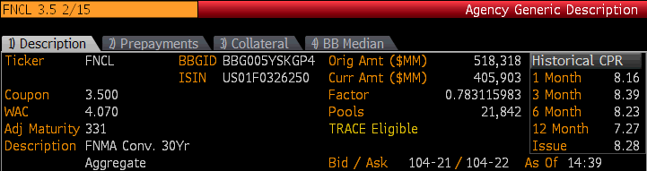
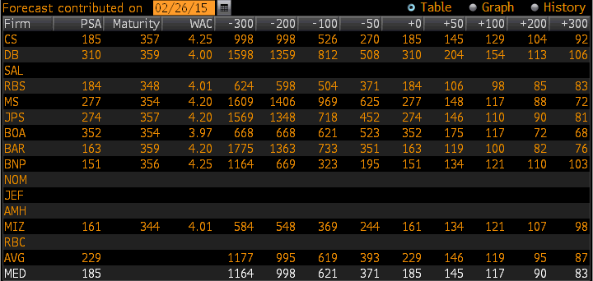
FNCL 3.5
Note that this TBA is different from the one provided last week
Use the Median “MED” PSA speeds below. Compare the prevailing mortgage rate and the gross coupon of loans in the TBA. For example, if the mortgage rate in your monte carlo simulation is 3.670%, then the prevailing mortgage rate is 40 basis points lower than the 4.070% WAC. In the table below, the speed would be interpolated between 371 PSA and 185 PSA, or 333.8 PSA. For rates beyond what are shown in the table, use the -300 speed (1164 PSA) and the +300 speed (83 PSA).

Slide 41
Impact of changing prepayment speeds
Holding interest rates and volatility constant, how would MBS prices be impacted
If the Market Value of a Passthrough was par (price = 100%) and then prepayment speeds increase and the yield curve is
1) flat
2) upward sloping
If the Passthrough is a “premium bond” (price > par), and then prepayment speeds increase and the yield curve is
1) flat or
2) upward sloping
If the Passthrough is a “discount bond” (price < par), and then prepayment speeds increase and the yield curve is
1) flat or
2) upward sloping
Breakout Rooms

Slide 42
Appendix
Other

Slide 43
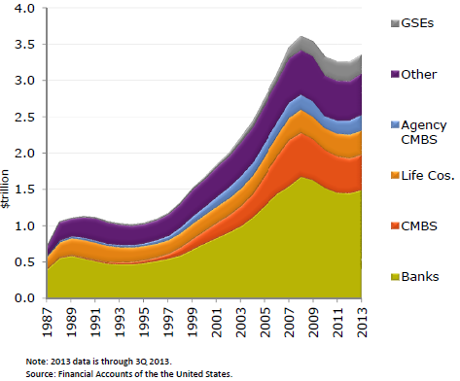
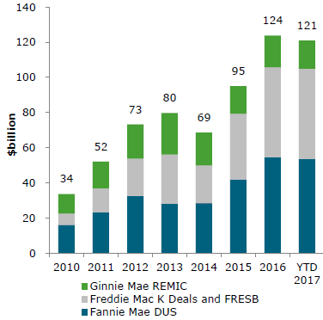
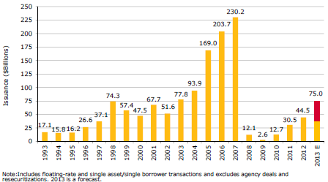
CMBS
For the first time in five years, outstanding commercial mortgages increased in 2013.
Commercial Real Estate mortgages have an outstanding balance of $3.14 trillion; up 1.7% from year-end 2012.
CMBS represents approximately 16% of the total in Commercial Real Estate debt outstanding.
Issuance increased since 2008/9, with Agency CMBS share larger post-crisis vs pre-crisis
Source: Wells Fargo Securities, LLC

Slide 44
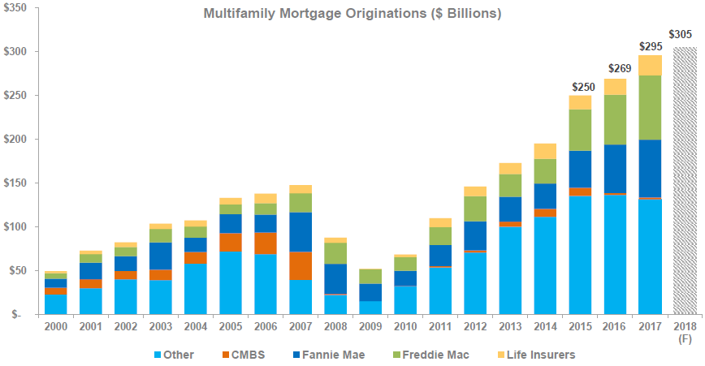
CMBS
Within the multi-family space:
Source: Freddie Mac

Slide 45
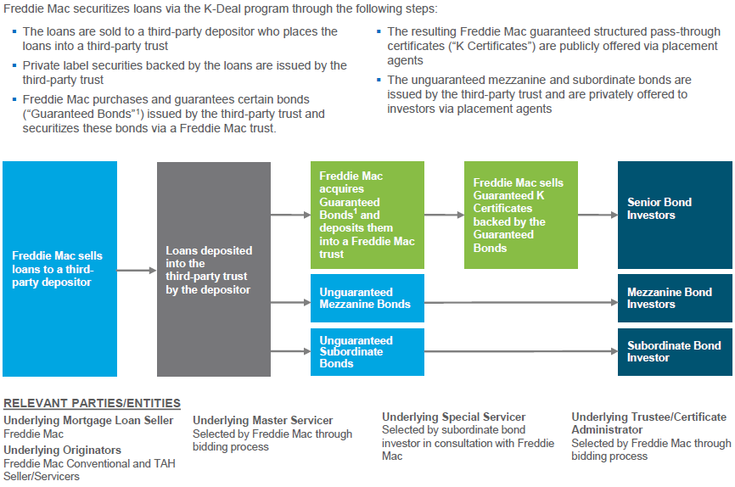
CMBS
Fannie: DUS (Delegated Underwriting and Servicing)
Freddie: “K-Deals”
Source: Freddie Mac

Slide 46
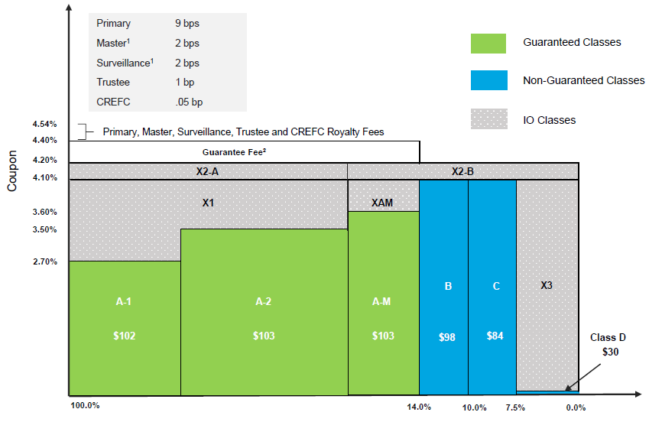
CMBS
A sample Freddie K-Deal
Source: Freddie Mac

Slide 47
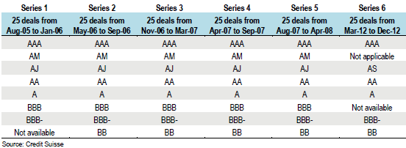
CMBX
Because of crisis, hardly any CMBS issued from 2009 to 2011

Slide 48
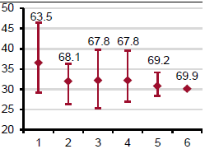
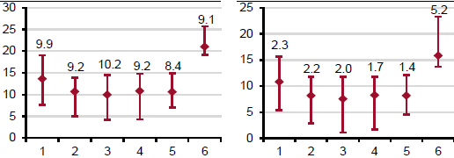
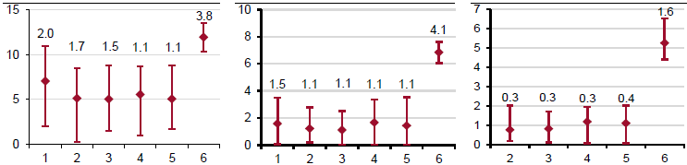
CMBX 1 through 6
Numbers: average thickness of tranche as a % of deal
Left axis: attachment point (amount of subordinated securities junior to the tranche)
Range and average of attachment points across the 25 deals composing the index
Notice for CMBX.6, no AM class and higher credit enhancement for AA, A, etc. tranches
CMBX AAA 1.0 3.0
CMBX AM
CMBX AJ AS
CMBX AA
1.0 only;
Graph not available
CMBX A
CMBX BBB-
CMBX BB
Source: Credit Suisse, Markit

